Slide 2
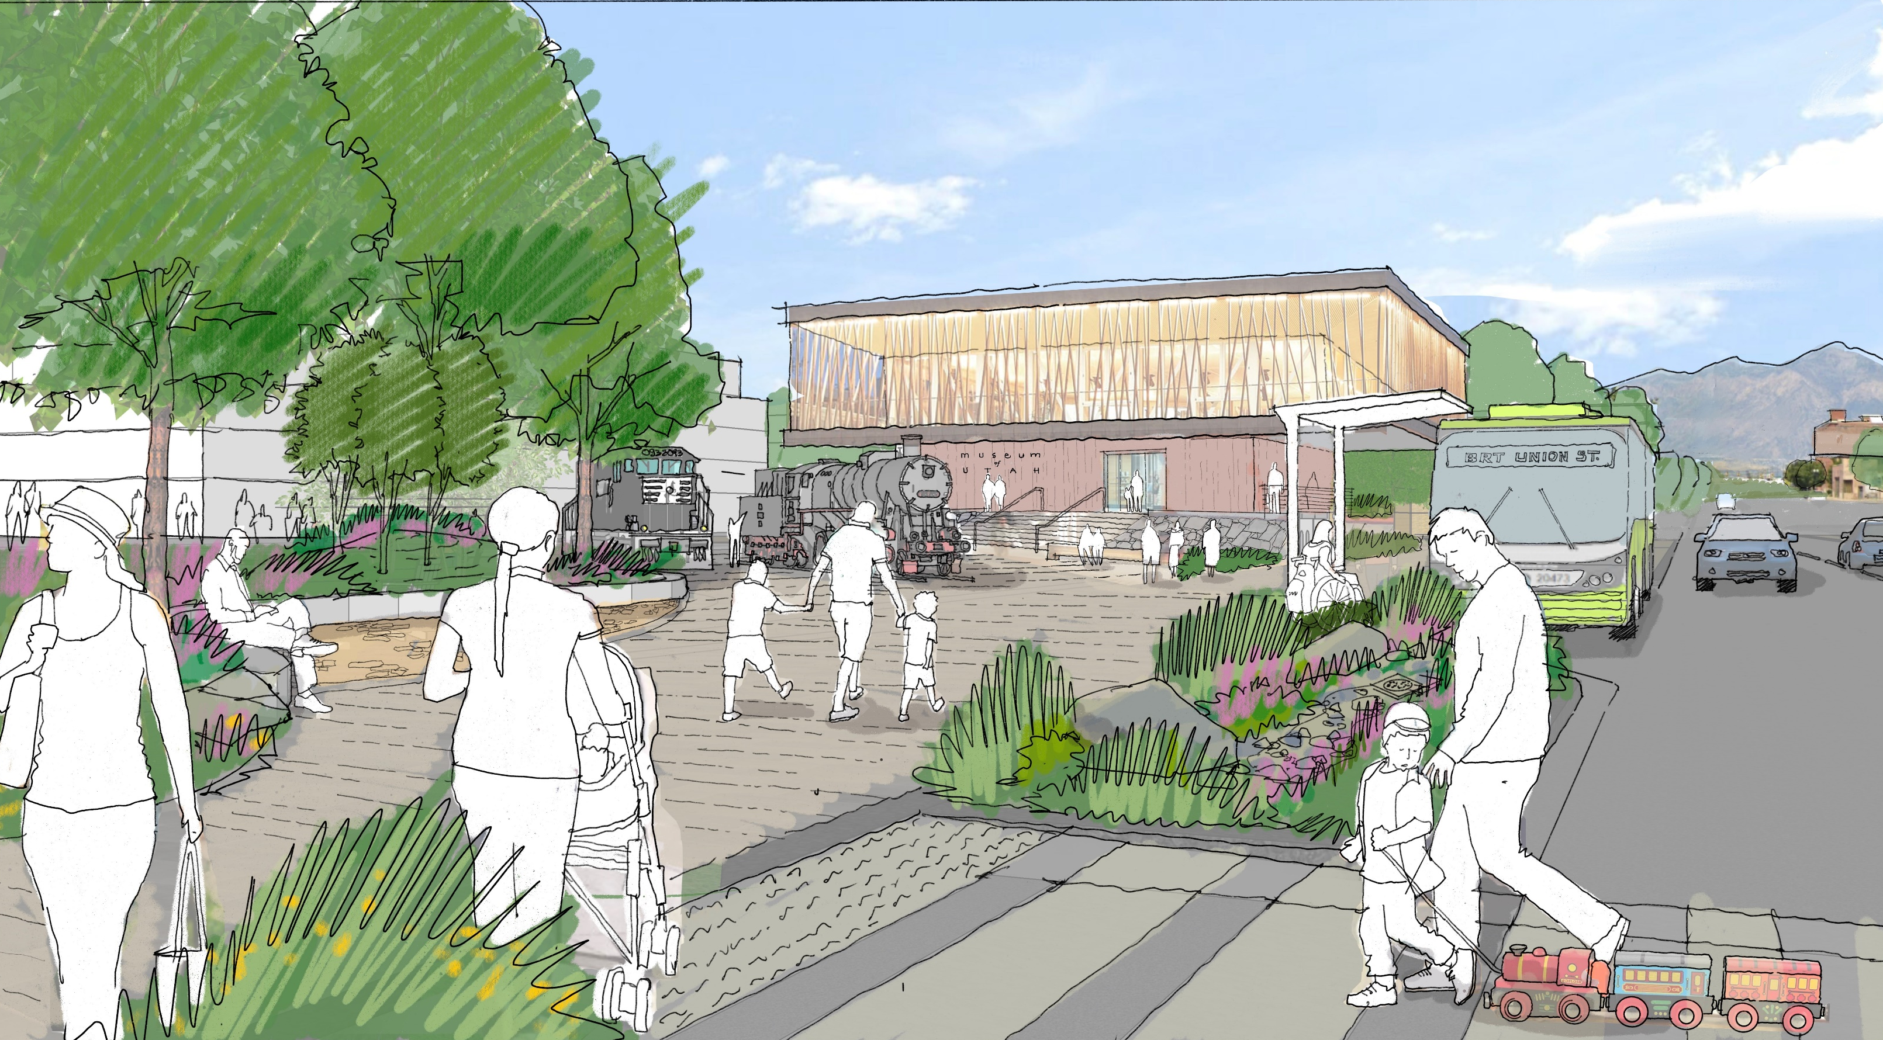
Wall Avenue Vision
Better connect Union Station to 25th Street
Serve as a multi-modal corridor
Reduce vehicular speeds through Downtown
Enhance the sense of pedestrian safety
Consistent character along Union Station Neighborhood and beyond

Slide 3
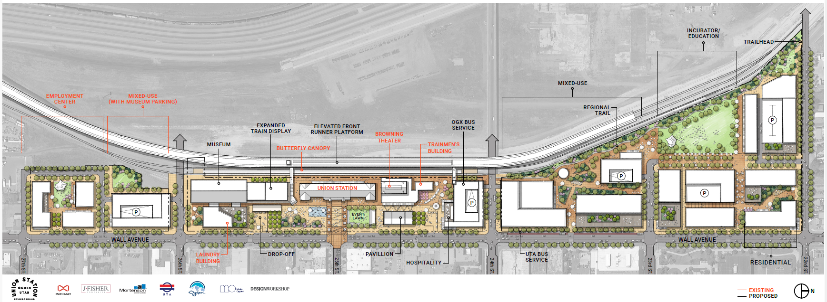
Union Station Plan

Slide 4
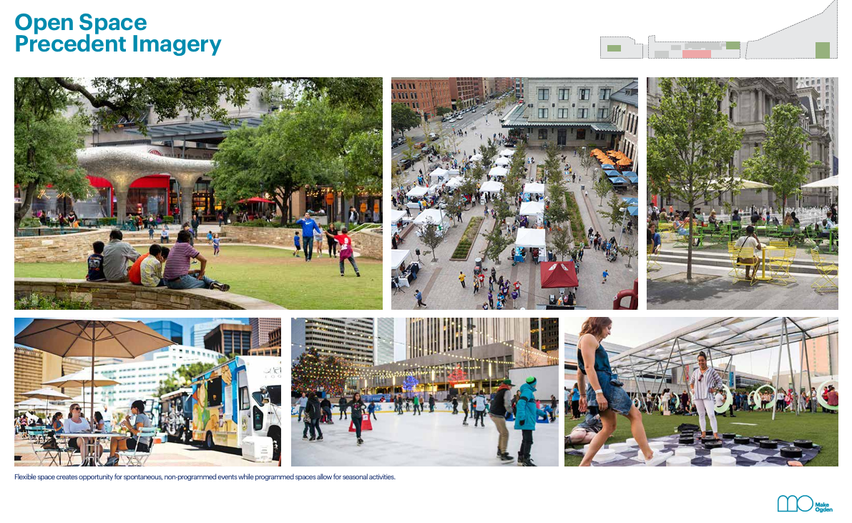
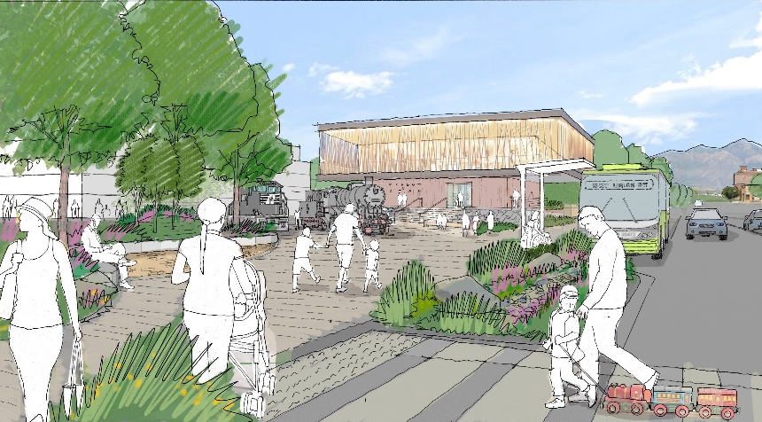
Concept Ideas

Slide 5
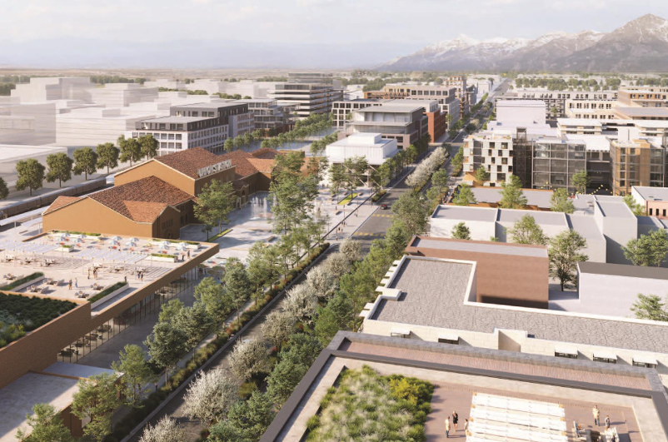
Concept Ideas

Slide 6
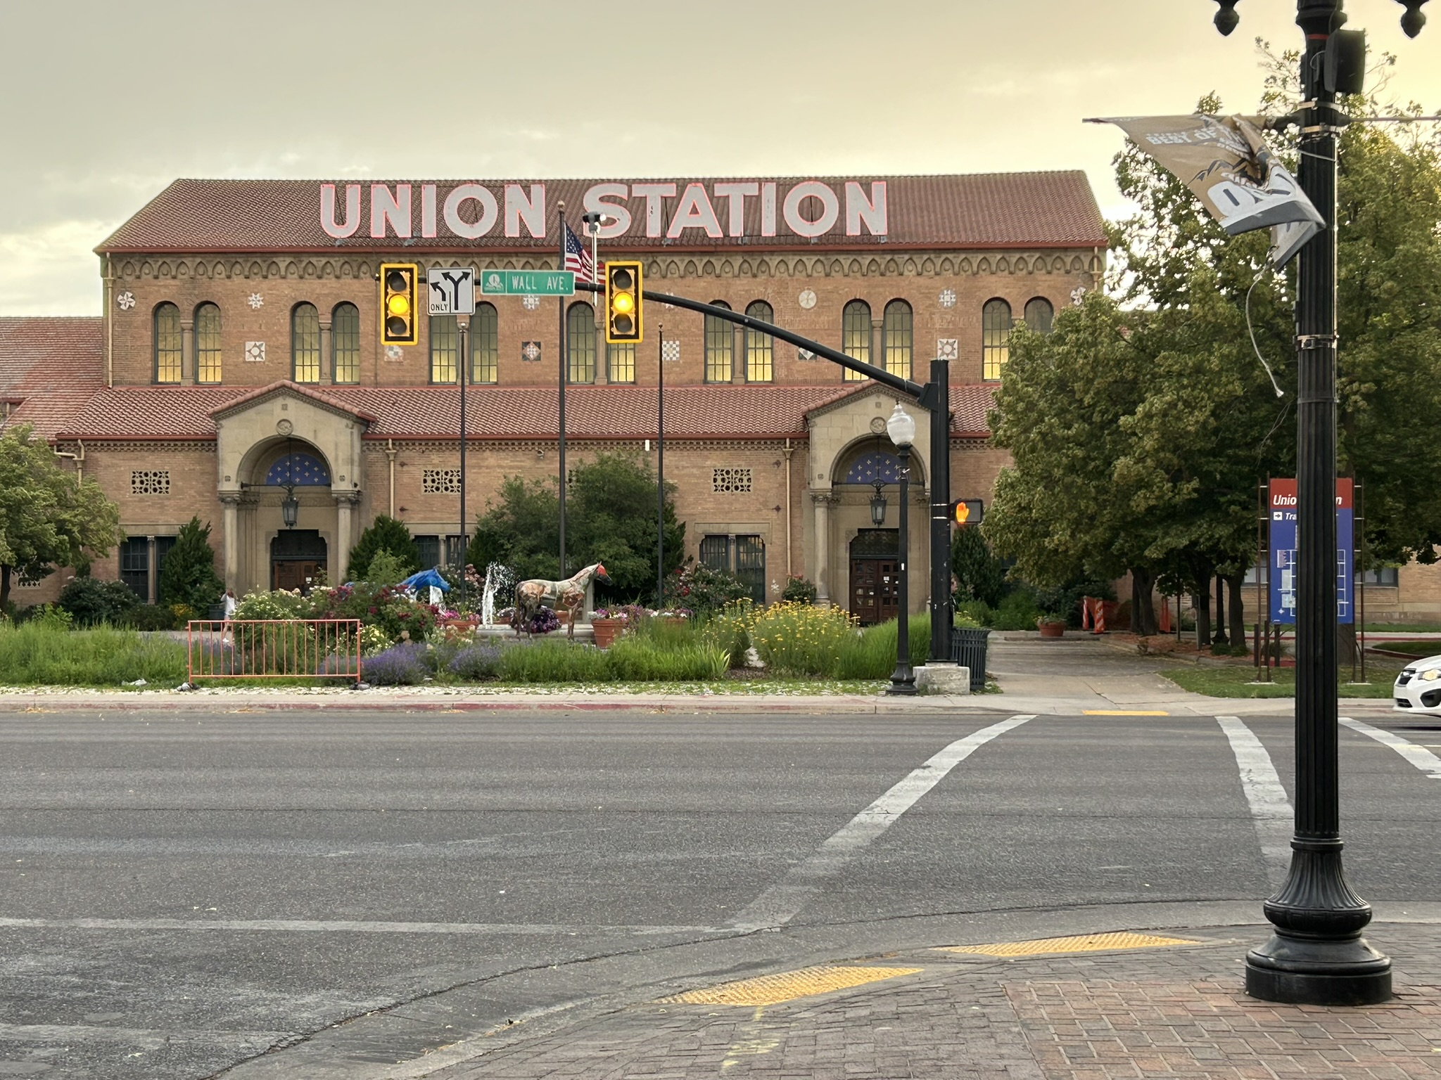
Project Purpose
Advance the vision through traffic analysis
Determine opportunities, limitations, and feasibility
Provide UDOT with technical foundation for future changes

Slide 7
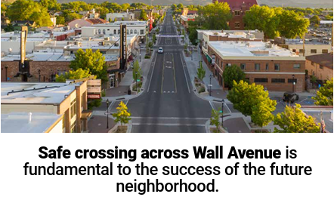
Union Station Goals
Safe Crossings of Wall Ave
Multi-Modal Transportation
Variety of Land Uses

Slide 8
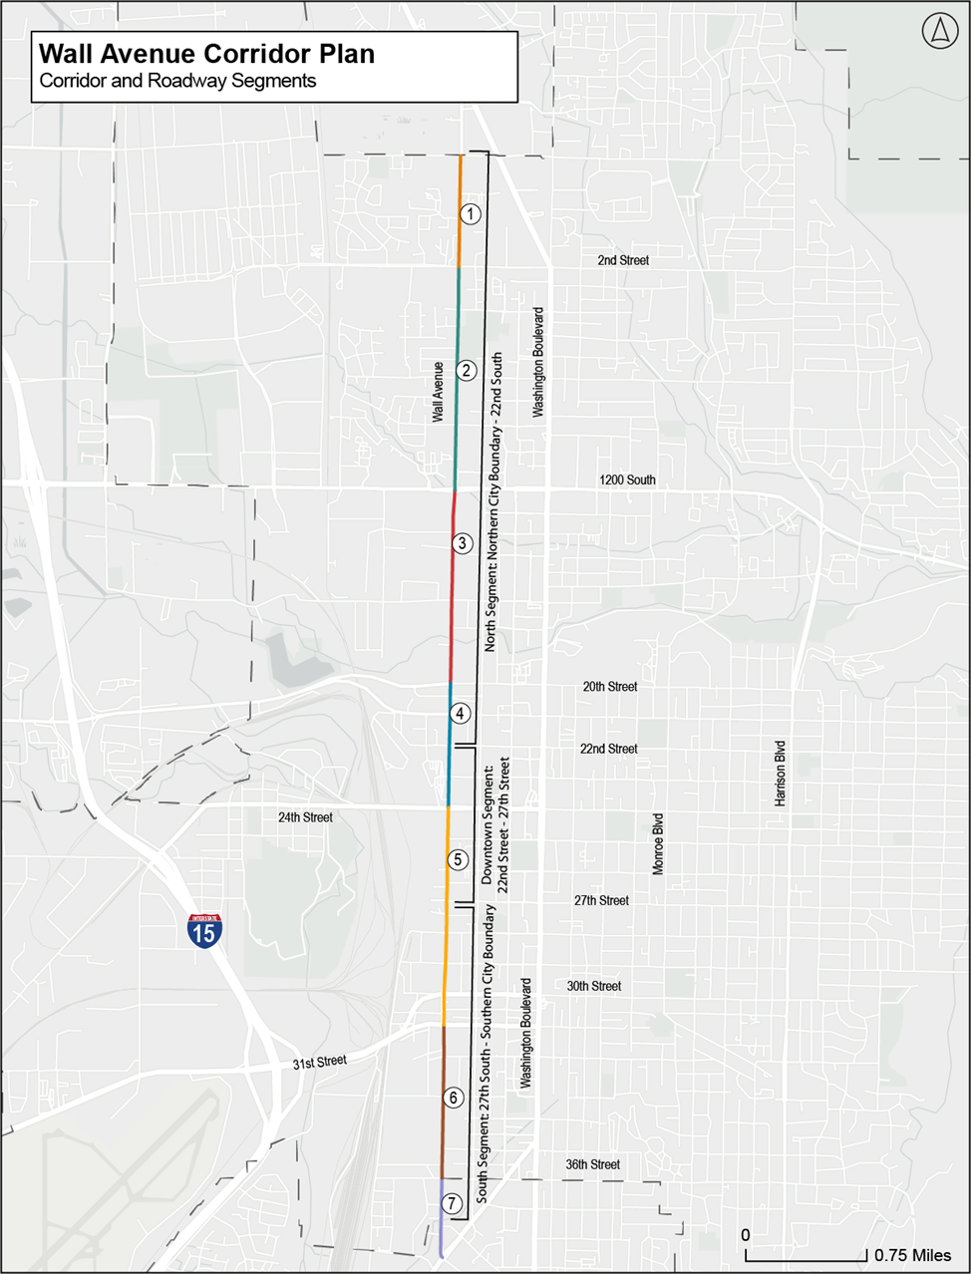
Study Area
Northern Segment
North of 22nd Street
Downtown Segment
22nd Street – 27th Street
Southern Segment
South of 27th Street

Slide 9

Existing Conditions Review
Previous Plans & Studies
Origin/Destination Data
Land Use
Traffic Analysis
Crash Analysis
Transit
Active Transportation
Parking

Slide 10
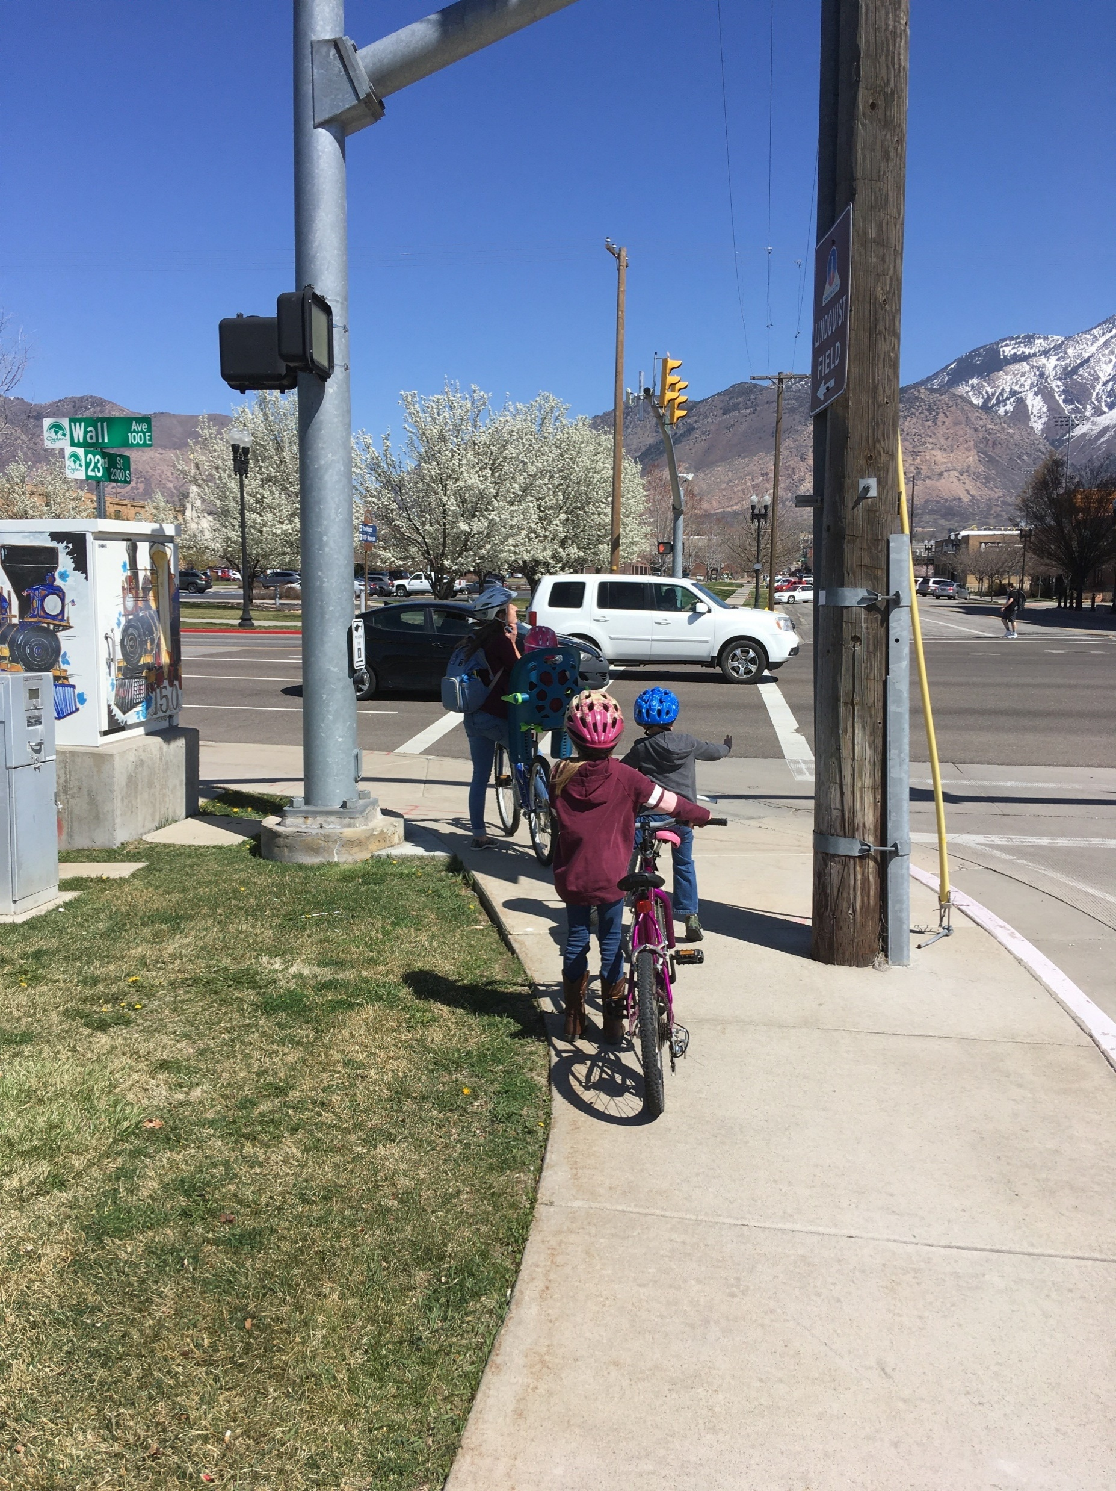
Downtown Segment (22nd – 27th)
Traffic Calming
Speed Reduction
Vehicle Capacity
Pedestrian Crossings
Traffic Analysis
Community Input

Slide 11
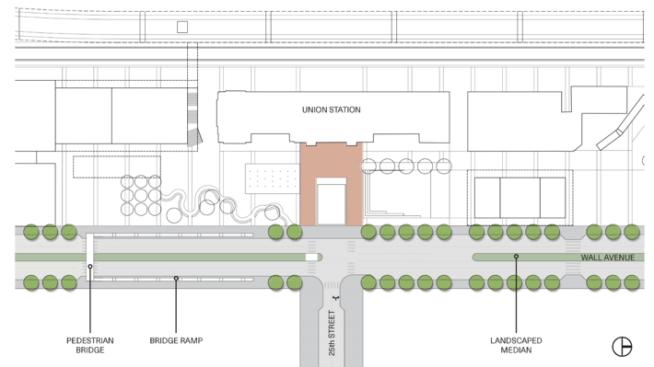
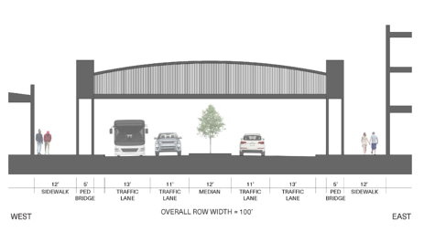
Pedestrian Overpass

Slide 12
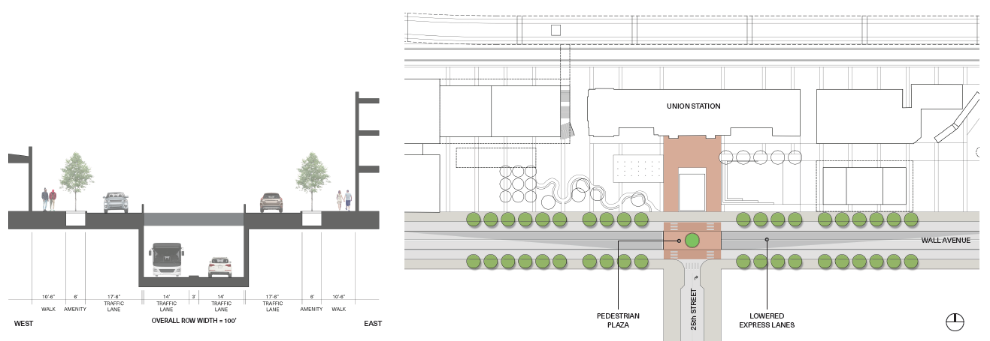
Pedestrian Plaza w/ Expressway

Slide 13
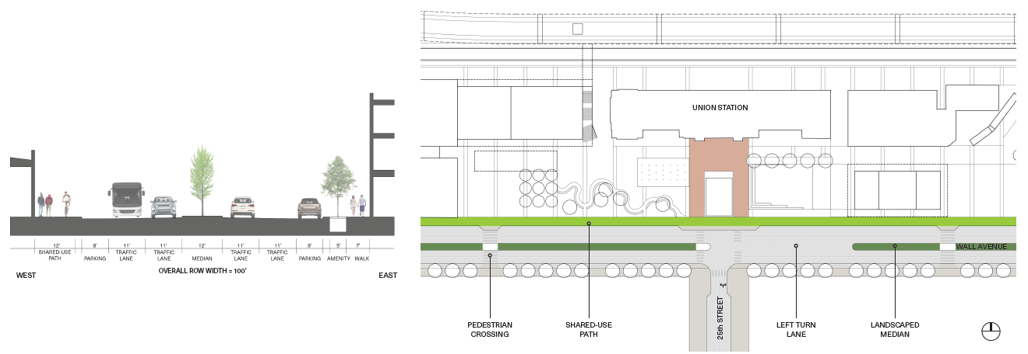
Traffic Calming w/ Multi-Use Path & Parking

Slide 14
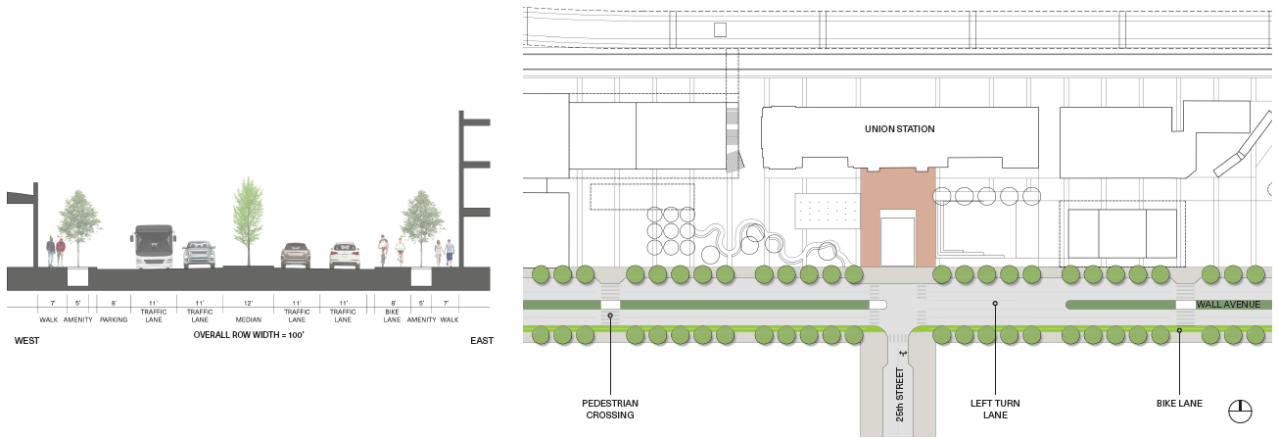
Traffic Calming w/ Bike Lane & Parking

Slide 15
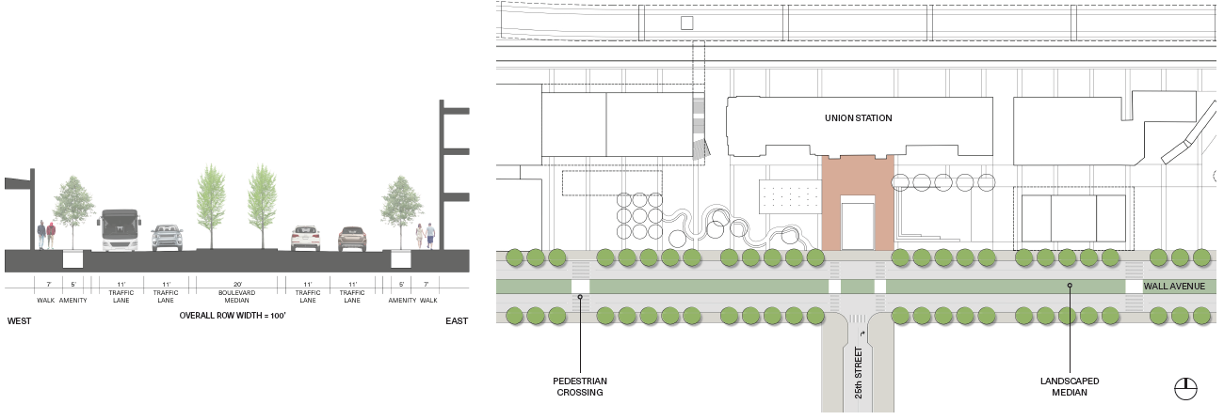
Boulevard

Slide 16
Traffic Calming w/ Bike Lane & Parking

Slide 17
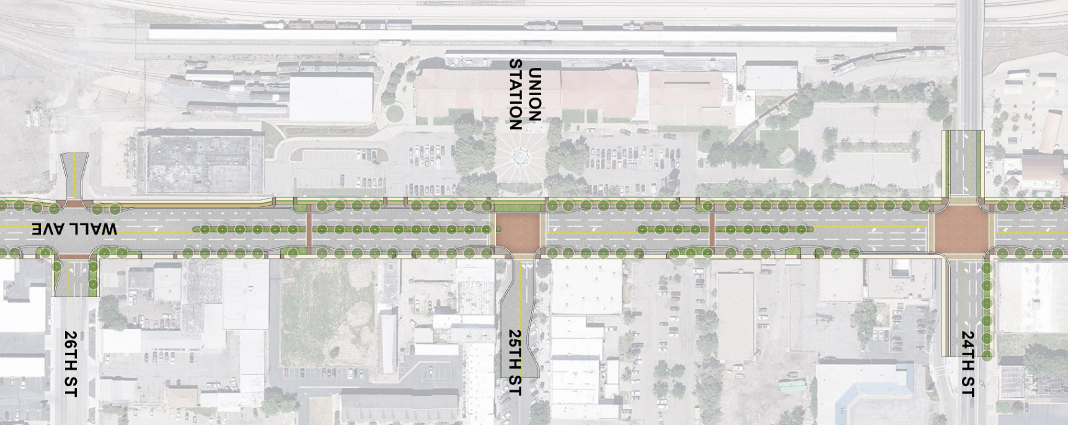
Preferred Concept

Slide 18
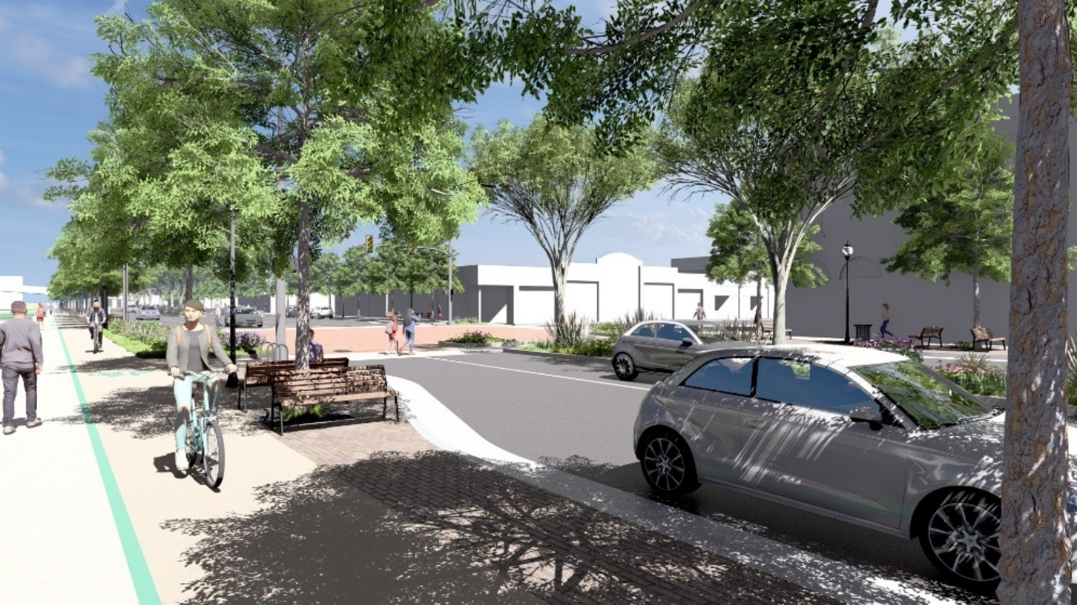
Preferred Concept

Slide 19
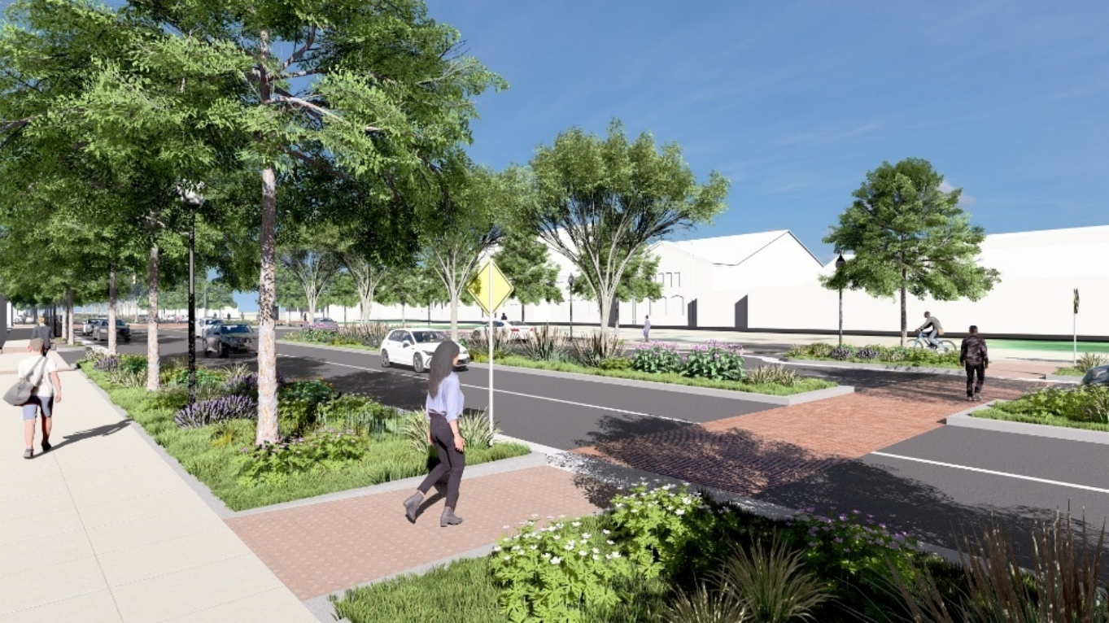
Preferred Concept

Slide 20
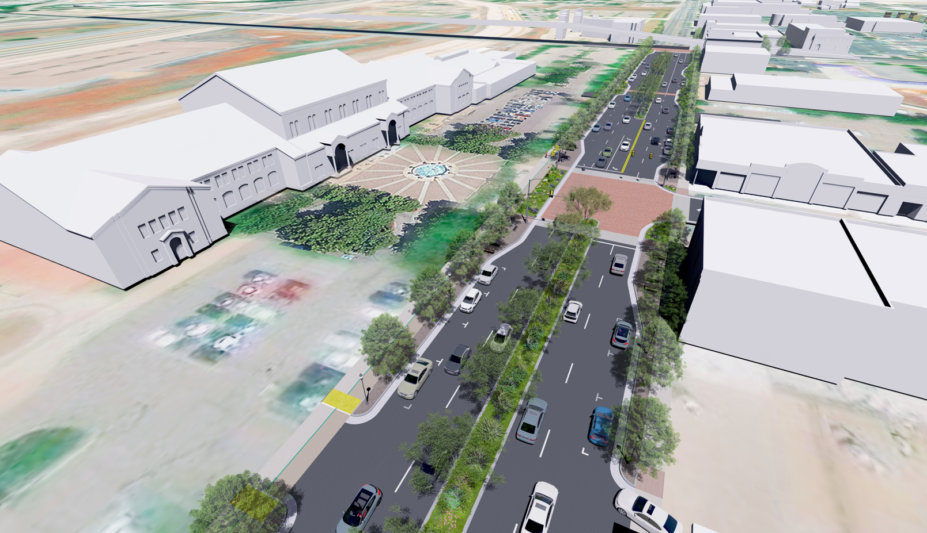
Preferred Concept

Slide 21
Northern & Southern Segments
Standard Improvements
Vehicle Capacity
Traffic Analysis
Available Right-Of-Way
Typical Cross-Sections
UDOT Standards
Areas of Need

Slide 22
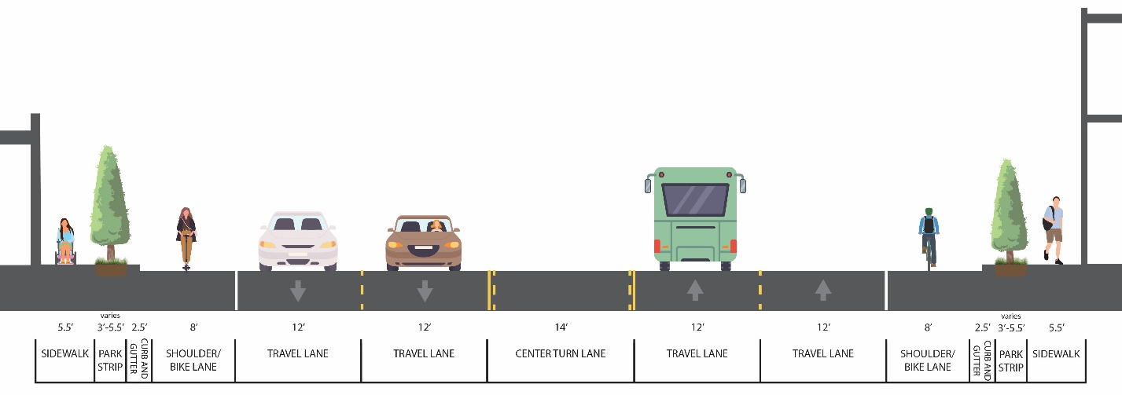
100’-105’ ROW Cross-Section

Slide 23
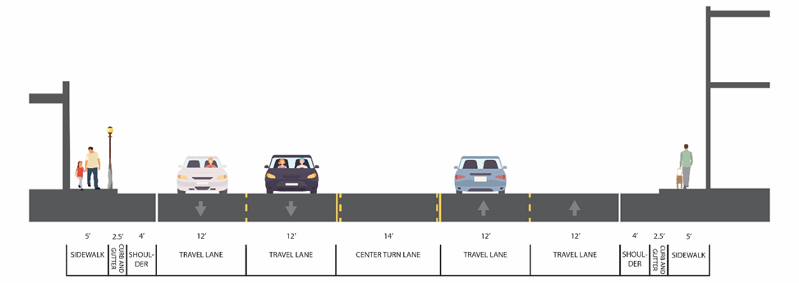
85’ ROW Cross-Section

Slide 24
Needs
Sidewalks
Curb & Gutter
ADA Pedestrian Ramps
Edge lines
Uniform Cross-Sections

Slide 25

Next Steps
Finalize Traffic Analysis
Implementation Plan
Draft Plan
UDOT Corridor Agreement

