Slide 1
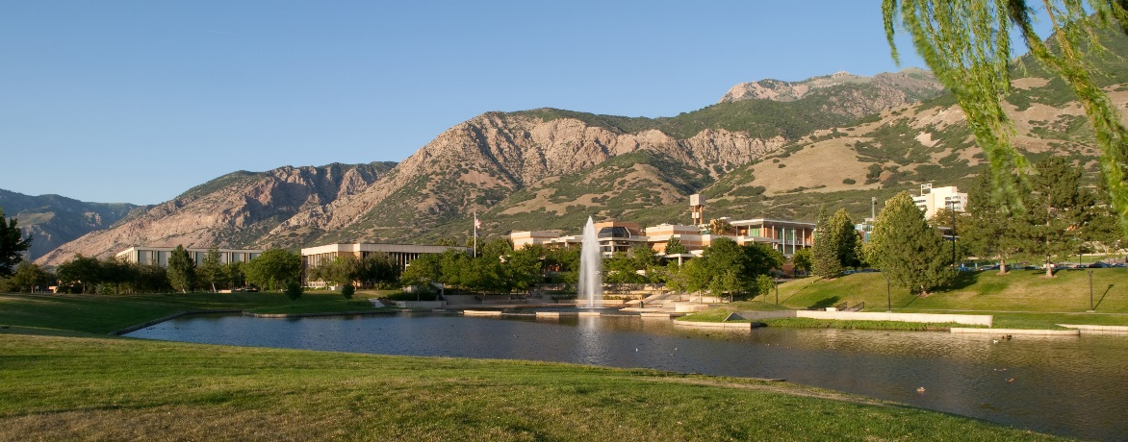
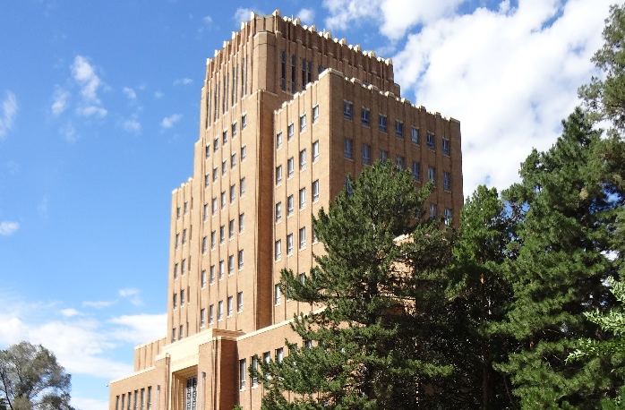
Weber State and Ogden: Defining each other through the College Town Initiative
2015 ADP/TDC/NASPA
Civic Learning and Democratic Engagement
June 6, 2015
Notes:
Brenda lead out

Slide 2


Presenters
Bill Cook
Executive Director, Ogden City Council
& Co-Chair of the College Town Initiative
Brenda Marsteller Kowalewski
Director, Center for Community
Engaged Learning and Professor,
Sociology at Weber State University
Notes:
Add logos for both organizations

Slide 3
Objective and Outcomes:
To share the story of Ogden City and Weber State University’s College-Town Initiative
Participants will gain:
Examples of initiatives with tangible results
Ideas for their own town-gown relationships
Notes:
Hands-up survey:
How many of you have your students engage with local city councils in some way?
How many of you currently have a town-gown initiative?
How many have a town-gown charter?
How many have a community engagement classification by the Carnegie Foundation?
How many are interested in a town-gown charter?
How many are members of the International Town and Gown Association?

Slide 4
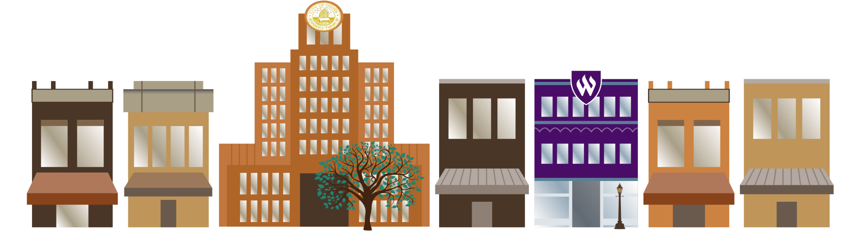
Recognized by the International Town and Gown Association
2015 Larry Abernathy Award for most robust town & gown relationship
Notes:
Show video

Slide 5

Notes:
Show video

Slide 6
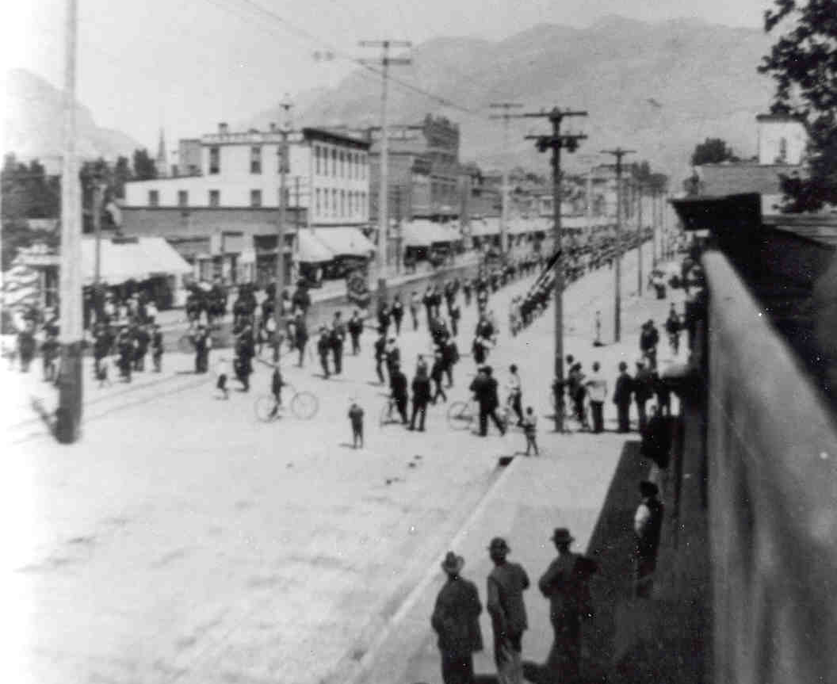
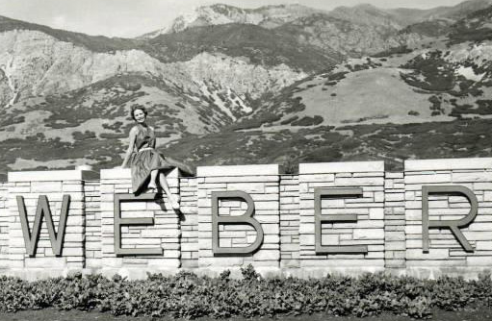
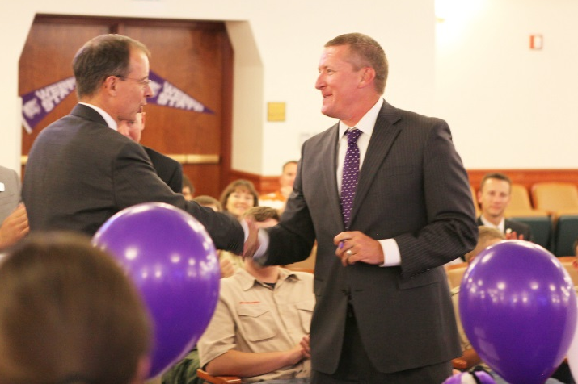
In the beginning …
Ogden was born in 1851 – 164 years ago
WSU was born in 1889 – 126 years ago
38 years single, 126 years married
We renewed our vows on October 1, 2013

Slide 7
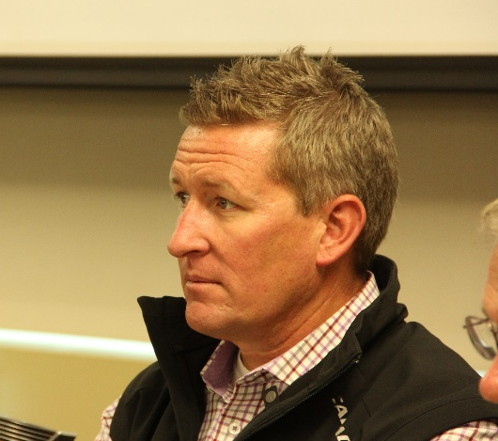
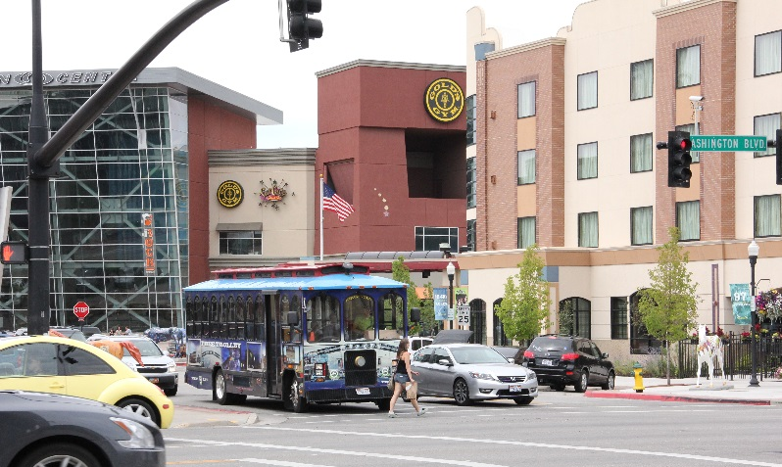
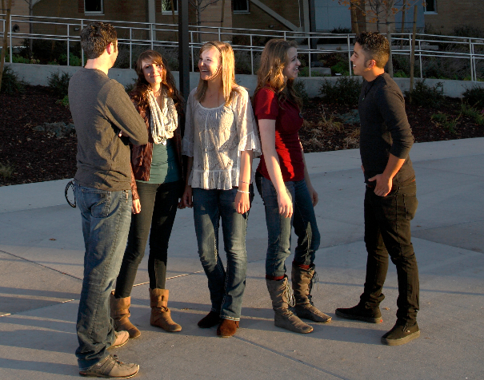
Kick-Start
This all started with student leaders meeting with Mayor Caldwell in early 2012 to explore options for working together
Informal survey – Is Ogden a College Town?
100% said “NO”!

Slide 8
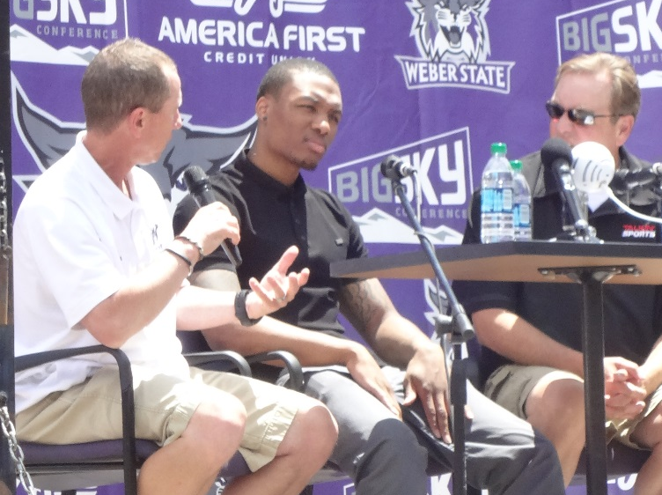
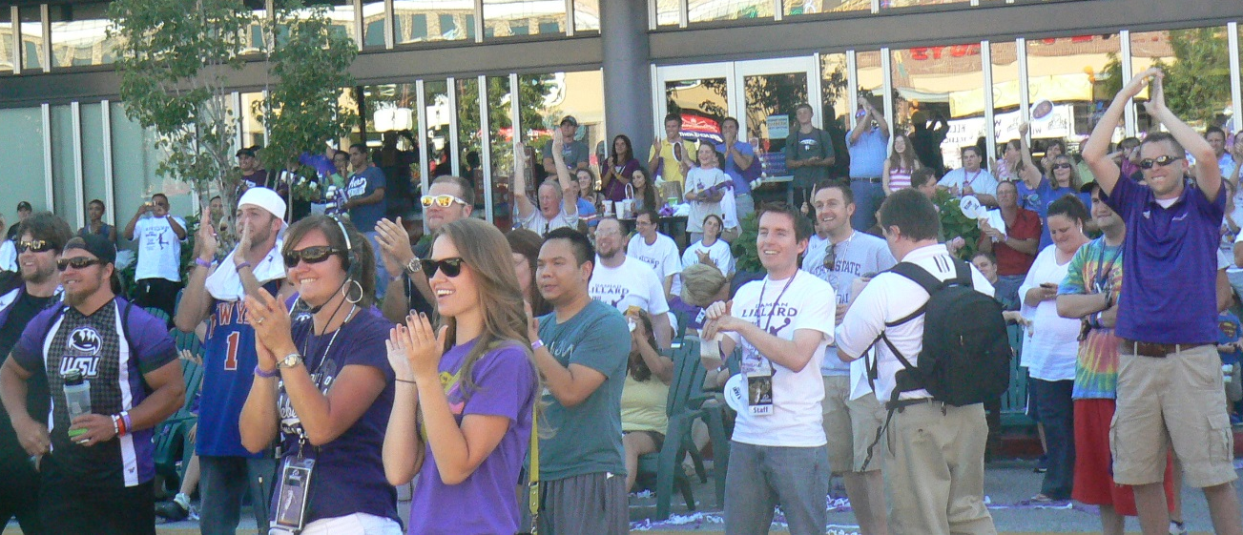
Opportunity comes knocking …
Damian Lillard Day proclaimed, key to the City
NBA Draft celebration – 400 people showed up
Damian is selected #6 overall
Excitement abounds and energy builds!

Slide 9
Additional Information
Find materials for this presentation when text is marked with * at:
http://goo.gl/1GoxTM

Slide 10
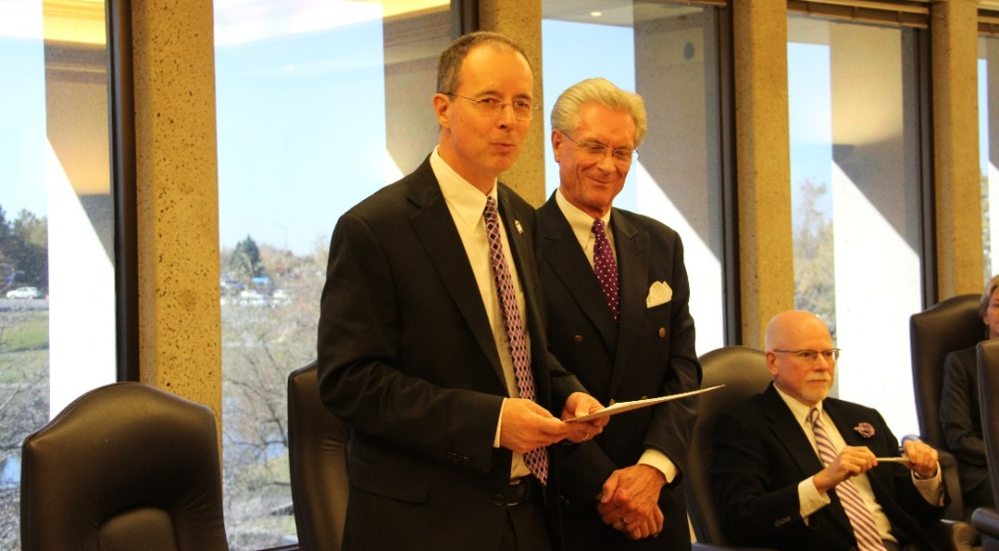
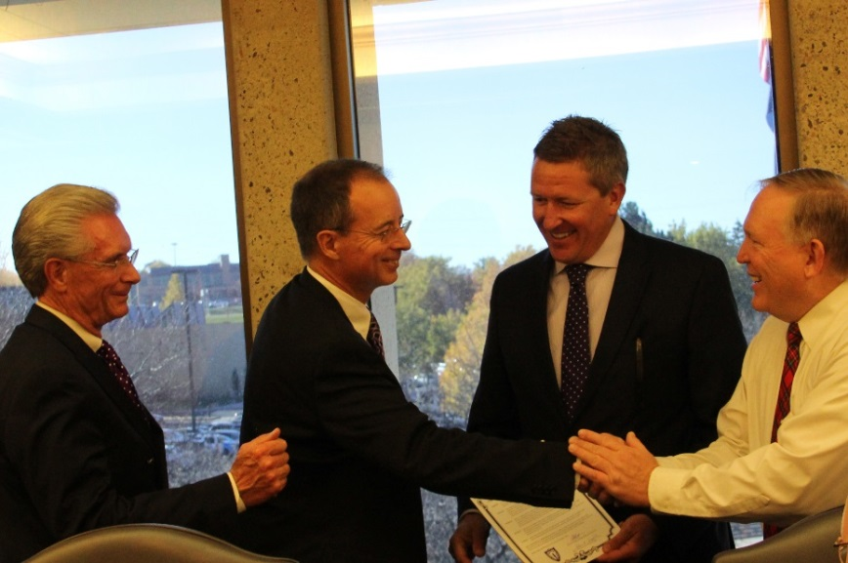
Joint Presidential Citation
Nov 4, 2014 – Recognition of Ogden City by Weber State via a Joint Presidential Citation*

Slide 11
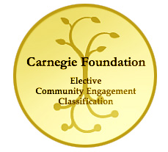
Carnegie Classification for Community Engagement - Process
2015 vs 2008
Task Force included Ogden City & other community partners
Sub-committee on partnerships co-chaired WSU and Ogden City representatives
Notes:
Carnegie Classification for Community Engagement was another opportunity to advance the College-Town Initiative and a great way to bring Ogden City up to speed about how WSU was already engaging with the surrounding community.
I’ll describe the process we employed to write the application
I’ll compare and contrast the 2015 experience to the 2008 Carnegie process and eventually the outcomes.

Slide 12
Carnegie Classification for Community Engagement - Outcomes
125+ community projects & partnerships
Community Partnerships Celebration
Bedrock Awards – 9 recipients
Keys to Our Communities Award – 7 cities
Shared pride and ownership
Notes:
Brenda slide
I’ll talk about the excitement that came out of the identification of projects & partnerships to highlight in the Carnegie application. WSU representatives were just doing our jobs but the city representation on the committee brought a new lens through which to view these projects and partnerships as part of the College-Town Initiative – as something to be celebrated and to have these stories told.
I’ll describe the role the city played in celebrating the partnerships and WSU’s receiving the classification once again in 2015 – the joint effort to celebrate on February 18th, 2015.
The amazing turnout and participation by local cities.
The long-standing partnerships honored that evening.
The Keys to Our Communities Award – currently 7 cities – plans for how we intend to increase this to all 50 cities in 4 surrounding counties
I’ll talk about how the university sees the Carnegie classification in 2015 as a joint classification of WSU and Ogden (and surrounding communities). The community and WSU alike are taking pride in the classification as there is no way WSU could have earned it on its own.

Slide 13
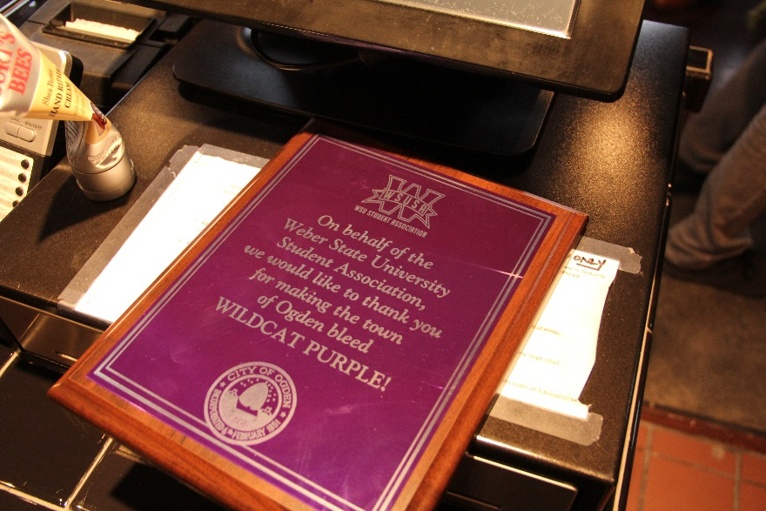
Benefits*
Mutual Benefits
Benefits to the University
Benefits to the Community
Notes:
Mutual Benefits
• Joint marketing collaborations to promote University and community events
• Joint community engaged events provide opportunities for elected officials, community
leaders, University leaders and staff, and students to work side by side
• University faculty and students provide a knowledge base to the City and are able to gain
experience in the process
• National recognition through the International Town and Gown Association through articles
and presentations at national conferences
University Benefits
• Outpouring of community support
• Better integration of students, faculty and staff with the Ogden community
• Enhanced awareness of the many efforts and positive contributions of the University
• Recognition of the role and accomplishments of the University by the City through
resolutions and proclamations
• Students are engaging community leaders in conversations about issues of public concern
• The University is more tightly and overtly integrated into the Ogden community because of
this partnership
• The University is more intentionally being used as a resource for the City more than ever
before
Community Benefits
• Students are providing community service on a wide array of projects – one million hours of
service since 2007
• Non-profit and government organizations have access to students and faculty to enhance or
augment services that are provided
• University programs and events are available to enhance the quality of life for the
community
• Collaborations between the University and community enhance the mutual pursuit of
economic, educational, recreational, social and cultural initiatives
• Community events are promoted to students, faculty and staff

Slide 14
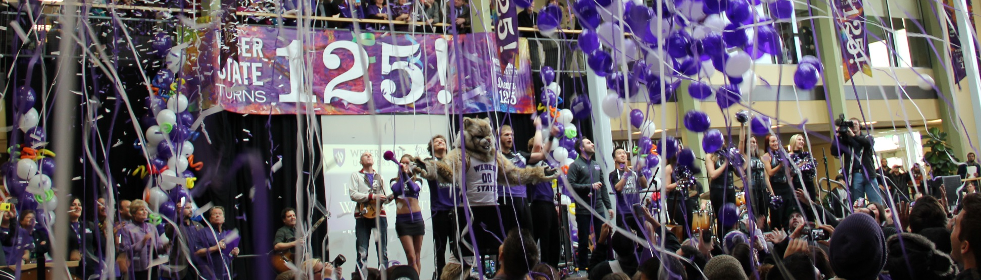
How did you do it? (so much progress in such a short period of time)
What’s the secret formula?

Slide 15
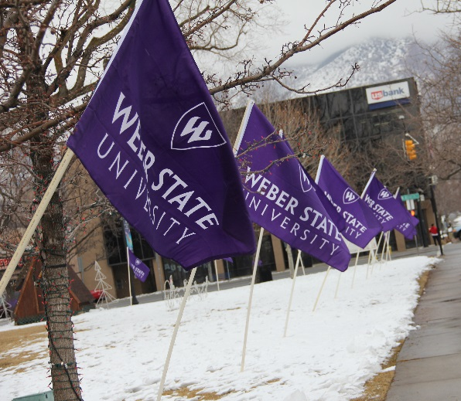
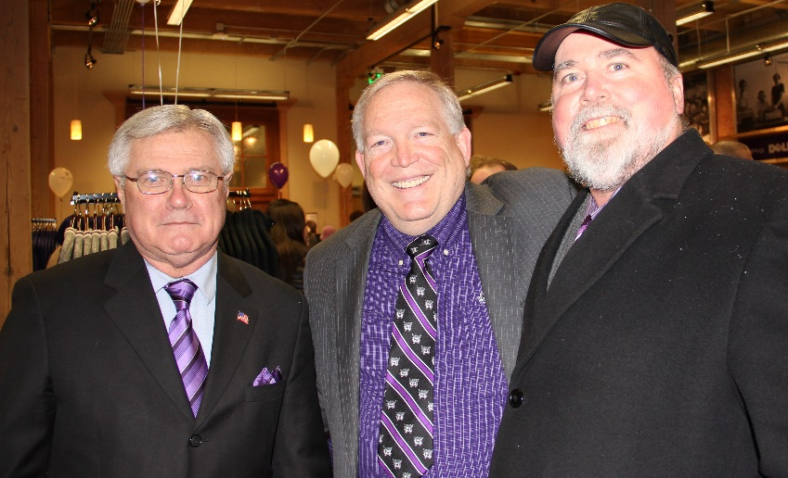
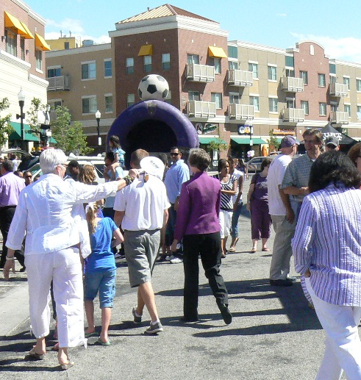
This is all about community building
We are using a collaborative
strategic planning approach

Slide 16
Collaborative Strategic Planning
Planning is all about people, their hopes and aspirations, their values and principles, what matters most to them, what they want their community to become, even what they feel.
Collaborative Strategic Planning in Higher Education,
Chapter 1 – Laying the Foundation by Patrick Sanaghan

Slide 17
Collaborative Strategic Planning
Community building is an outcome of good planning that consciously involves diverse stakeholders in a transparent process about what truly matters in their community.
Collaborative Strategic Planning in Higher Education,
Chapter 1 – Laying the Foundation by Patrick Sanaghan

Slide 18
Key components
Obtain a joint commitment
Create a safe space to dialogue
Proceed quietly
Show personal commitment
Build trusting relationships
Find and follow the energy

Slide 19

Obtain a joint commitment to proceed with the initiative
WSU President, Mayor and the City Council
agree to pursue “becoming a college town”
Both joined ITGA and attended
certification training
Concept Group formed – 5 Weber State,
5 City, Co-Chairs – and visioning session held

Slide 20
Create a safe space to dialogue about anything through a charter
Formalize the relationship through a College Town charter*
Create a vision statement
Include a committee structure
Develop measures of success*

Slide 21
Vision Statement
Our community is known as a unique and vibrant place where Ogden City and Weber State University mutually pursue economic, educational, recreational, social, and cultural initiatives. This effort creates pride and tradition that binds us together.

Slide 22
Committee Structure
Executive Committee
Steering Committee
Marketing Team
Advisory Committee

Slide 23
Proceed quietly – no fanfare
Joint marketing team developed all
communications
Our goal – to have everyone see and
feel the changes to create a positive
buzz
Notes:
Bill, I would like to add verbally to each of these “key components” slides where appropriate to represent how WSU or at least CCEL has proceeded in the College Town Initiative in alignment with these key components.

Slide 24
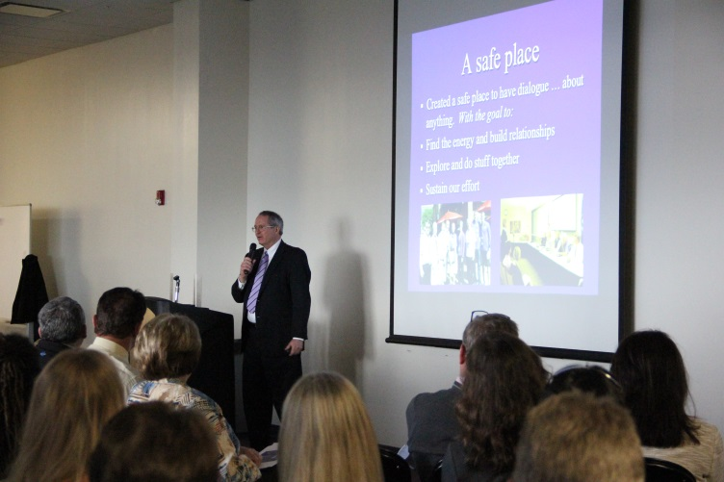
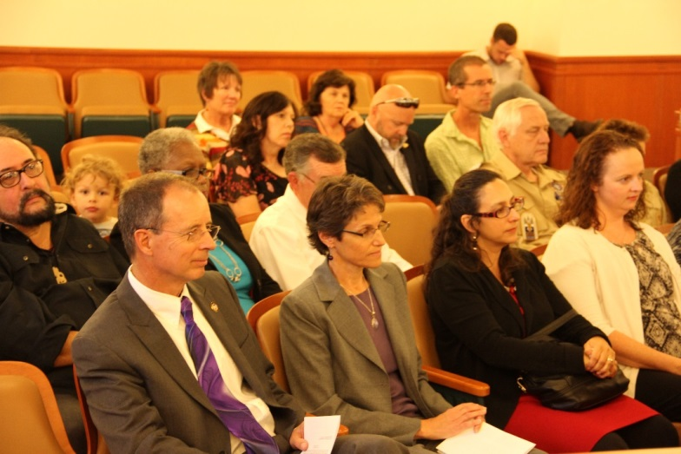
Show personal commitment
Dedicate the time
Coordinate and lead
Wear the colors
Show-up

Slide 25
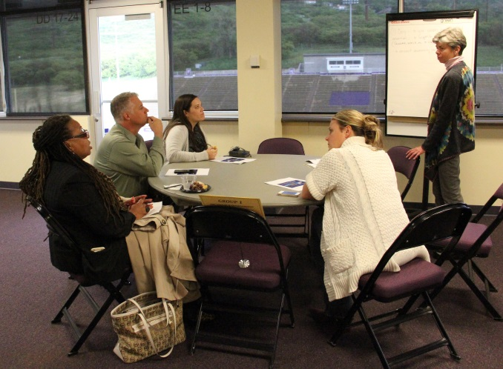
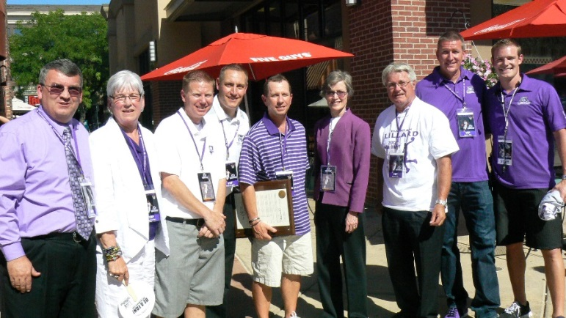
Build trusting relationships
Meet with leaders one-on-one
Share your vision, excitement, commitment
Follow-up email – thanks

Slide 26
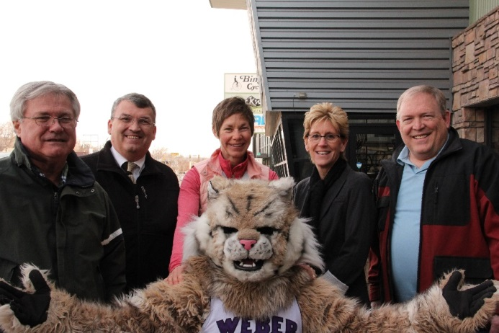
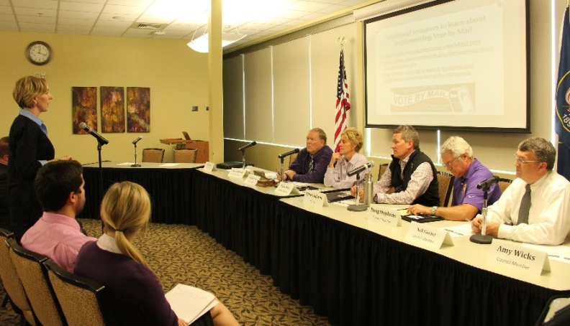
Find and follow the energy
This is a discovery process
Look for interest, excitement, opportunities
Pace yourself as best you can (Carpe diem!)

Slide 27
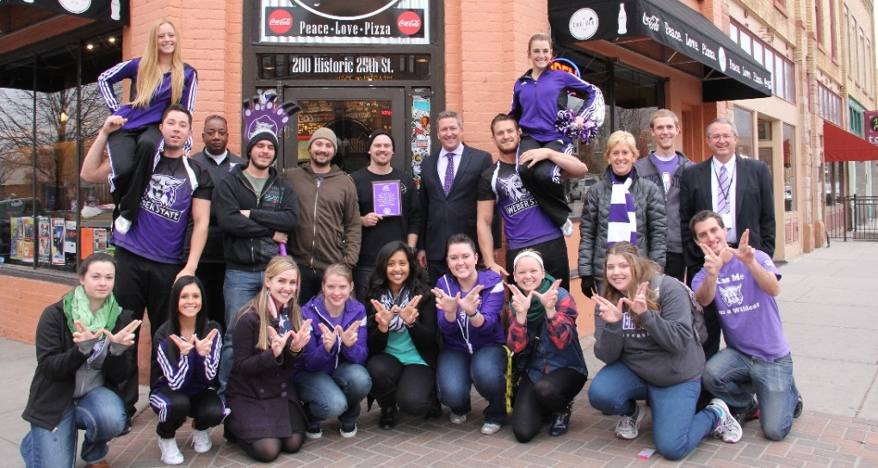
Initiatives
Progress report*
Students
Wildcat Choice Awards
WeberTown
Notes:
Bill

Slide 28

American Democracy Project Events
Talk of the Town (town hall meetings on campus)
Parking, Vote-by-mail, Ogden City diversity
Deliberative Democracy Day Panel
Impact of athletics programs, Minimum wage
Powered by Pizza
Taxes
Notes:
Bill, I would like to tag-team with you on the initiatives listed on these “initiatives” slides because some of them (many of them) are affiliated with CCEL. Are you good with that? We can just do this verbally. It doesn’t need to be scripted. I just want to know if you are cool with me chiming in.
All of these American Democracy Project events listed on these slides are out of the CCEL so if I could talk just a bit about the CCEL and how we facilitate democratic engagement first, I think that would provide a nice set up to this slide full of American Democracy Project events.

Slide 29
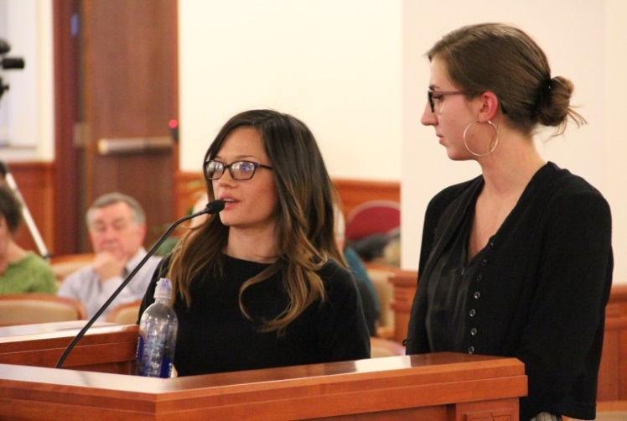
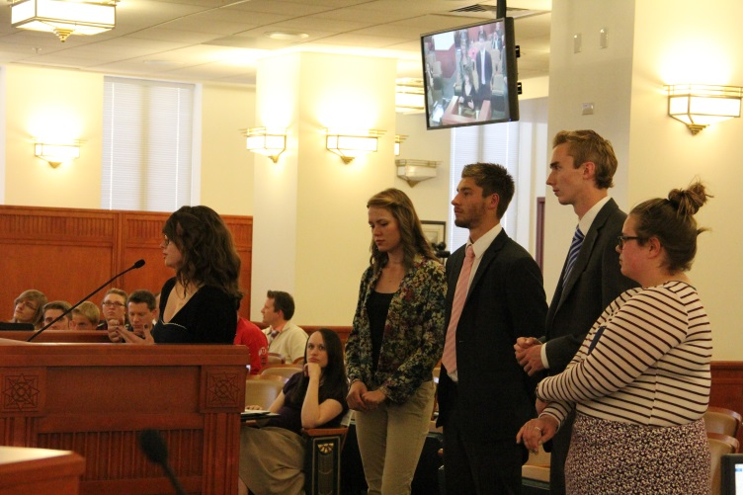
Initiatives
Debate Team
Predatory towing
Vacation rentals
Weber Speaks*
Formula-based businesses in Downtown Ogden
Notes:
I would like to talk about our CEL designation on classes and how that infrastructure has lent itself to these College-Town Initiatives listed on this slide.

Slide 30
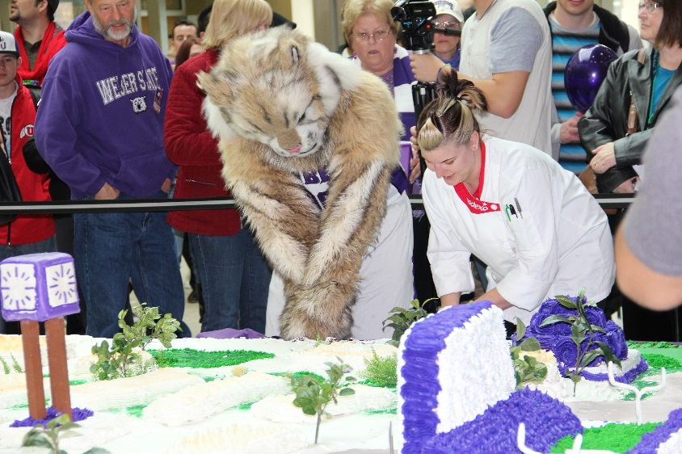
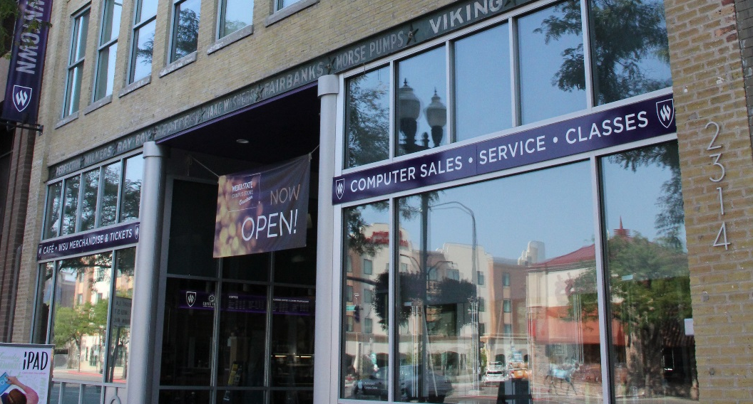
Initiatives
125th Anniversary Celebration
Weber State Downtown
Weber State Community Education Center
Notes:
The CCEL-CRE is located in the Community Education Center and I would like to be able to talk a bit about that infrastructure too as it supports the College Town initiative.

Slide 31
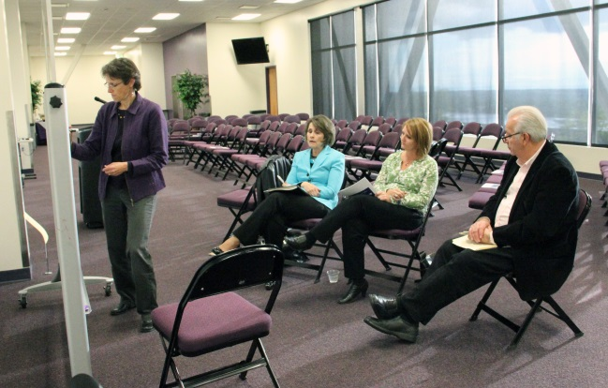
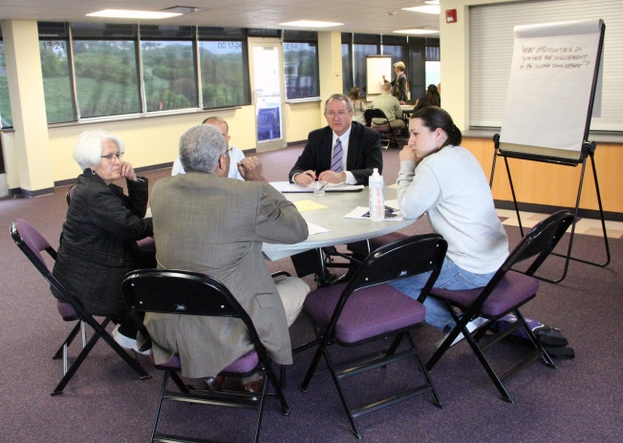
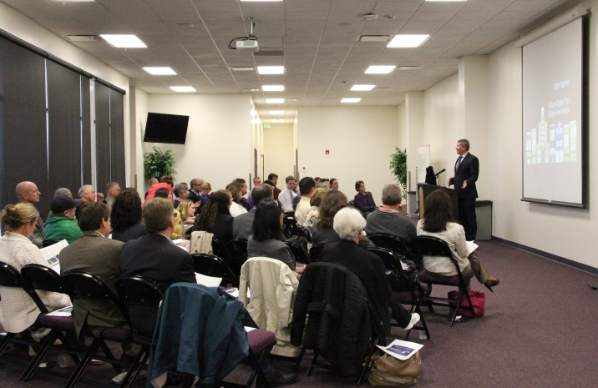
Initiatives
Citizens Academy*
Diversity Connections*
Advisory Committee*
Notes:
Add photos

Slide 32
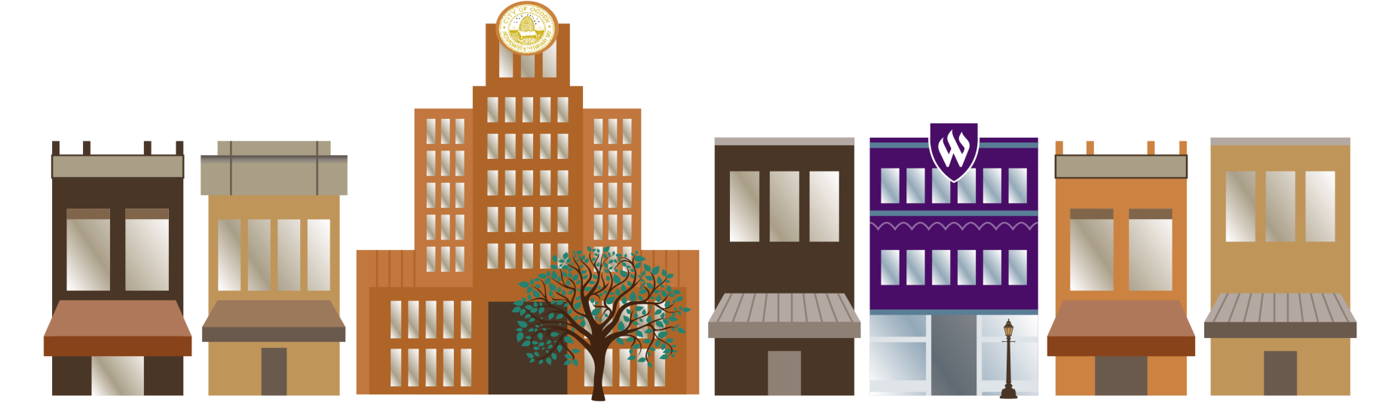
Thank you! [And best of luck with your effort]

